Slide 1
Diablo Assignment
By Nikolas Stark

Slide 2
Tasks
Your task is to create a game similar to the provided diablo.exe using the game concept that can be seen in the file “Diablo Console Game.docx”
This is group task, your group should consist of three to four people.
You should use Microsoft Visual C++ 2010 or newer version because after attempting 6 top Editors and 3 Compilers, I found out Ms VC++ is the best (although still has several flaws). It is easy to use, and suitable for beginners.
The purpose of this task is for you to:
understand the core essence of OOP
have an experience in designing and implementing OOP concept
have Good Programming Habits and good OOP structure
understand abstraction and encapsulation in programming context

Slide 3
Rules
NO PLAGIARISM among different groups!
There should be no function outside class! In other words: all your owned function must be method in class. The only function outside class is void main().
There should be no global variable (except for global constant or macro #define).
All data member should have access control private/protected! Data member should only be accessed from outside class using method. This will ensure good encapsulation and abstraction.
You must use Console class provided in attachment to manipulate console. Do not use cout or printf to print to console.

Slide 4
The Concept of OOP
Remember the idea of OOP is abstraction and encapsulation.
Abstraction means you design class that implements an idea and simplifies the user that uses the class by hiding complexity and offering only service of what the user really needs.
Encapsulation means you create integrity within your class so that outside class cannot modify directly the internal structure of the class.
The purpose of encapsulation is pursuit of integrity: keeping consistency of your design and avoiding corruption of its data member.

Slide 5
Tips
You can use any standard library provided by Microsoft Visual Studio like <stdio.h>, <windows.h>, <iostream>, <vector>, <string>, <chrono>, ... either it is procedural or object-oriented does not matter.
Some classes can be designed to be non-instantiable, such class is called helper class like Console class that I have provided. This class has only static method and static data member.
Follow the coding style that you can see in Console class, including the documentation and commenting style. This is one way for you to learn Good Programming Habits.
Focus on purpose first, ask yourself “what am I trying to achive?” or “what is my intention?” rather than focusing the code or bug. The code is made based on your intention. You can revise/change the code as long as it fits the purpose and follow the Good Programming Habits.

Slide 6
Guides
Remember, C++ is hard and complicated if you don’t keep everything in one consistent style. C++ actually easy if you keep your style simple and always focus on purpose rather than syntax. You can use the following coding style or guides:
If you need global variable that can be accessed anywhere use static data member with public access control.
Always stick to pass-by-pointer for passing object. Declare const if you don’t need to modify the parameter. Avoid using pass-by-reference and pass-by-value.
BAD:
float calc_total(Circle c1, Circle c2) {
return (c1.x + c2.x) / (c1.y + c2.y);
}
GOOD:
float calculateTotal(const Circle *c1,const Circle *c2) {
return (c1->x + c2->x) / (c1->y + c2->y);
}
Use dynamic-object-creation style using pointer variable, and new keyword:
BAD:
Circle c1;
Circle c2(3.0f,2.0f);
GOOD:
Circle *c1 = new Circle();
Circle *c2 = new Circle(3.0f,2.0f);

Slide 7
Naming Guides
Use lower-case for the first letter and camelCase naming convention (instead of underscore) for method and data member.
BAD: Line_count, Init_component(), Chr_idx
GOOD: lineCount, initializeComponent(), charIndex
Use upper-case for the first letter and camelCase naming convention for class name.
BAD: string, file_operation, sound_func
GOOD: String, FileManager, SoundManager
Your method should have meaningful word and should NOT contain abbreviation (as long as it is less than 25 characters):
BAD: readfl(), mkfn(), iter_inp()
GOOD: readFile(), createNewFile(), parseInput()
Use uppercase and underscore for static constant class member, for example: MATH_PI, MAX_BUFFER, CHAR_COUNT, …
Avoid using copy constructor and any statement that implicitly calls it. Create and use your own copyFrom(other) method.
BAD:
Circle c = d; // implicit call to copy constructor
GOOD:
Circle *c = new Circle();
c->copyFrom(d); // clear

Slide 8
Array Guides
Use array of pointer if you want to have an array of object (lots of object with same class type).
BAD:
Circle circles[10]; // implicit object creation
GOOD:
Circle *circles[10]; // array of pointer to Circle object
for (int i=0; i<10; i++) circles[i] = new Circle();
Avoid using 2 dimensional array and pointer to array of char because managing and passing those to parameter is complex in C++. Use string class in standard library by #include <string> or create your own.
BAD:
char *arrStr[100]; // avoid using this to create arr of string
char arr[100][100]; // avoid using 2 dimensional array
GOOD:
string *arrStr[100]; // create array of pointer to 100 string
If you have 2-dimensional array or more, encapsulate your array in a class.

Slide 9
Design Guides
Design your class diagram first in paper or any other tools and define each class’s purpose before you code.
After you finish your design, one of your members should put that drawing in computer as image by using available authoring tools such as Adobe Photoshop, Adobe Illustrator, or Ms Visio. If you use Ms Visio choose Software->UML Data Model. In UML the term method is Operation while data member is called attribute.
Design your program using hierarchy concept, that is, the one that is in higher position (supervisor) can access its member in lower position. Lower position cannot access other branches/siblings without going into its “supervisor”.
For each method in a class you should also define the purpose and describe the required parameter by using method describer.

Slide 10
Group Guides
Ideally a group consisting of 4 people have:
A designer/architect, who understands the program and can manage concept and can design classes, along with their purpose, data members, and their methods.
A documenter, who puts the design and documentation about existing classes into computer format using authoring tools.
A coder who is expert in syntax and C++ code, and will implement the design using Microsoft Visual Studio.
A tester who is testing the robustness and correctness of class after being implemented by coder.

Slide 11
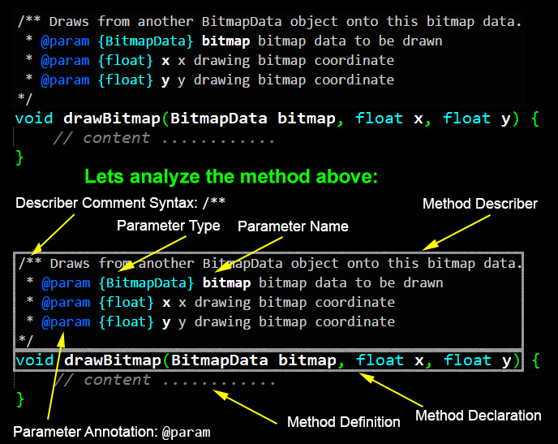
Good Programming Habit Example: Method Describer

Slide 12
Additional Info
Don’t mind about bugs or confusion you found during running my program “diablo.exe”. The most important thing is for you to match the concept of this game in the provided “Diablo Console Game.docx” NOT in the program “diablo.exe”. That program is created just for giving illustration to you.
You can create different interface as long as the concept of the game remains the same.
You may decorate with colorful, unique, beautiful, and friendly design. It does not have to match with the program I made. Use Console class provided to help you achieve this.
You can provide cool animation if you are able to (animation is optional).

Slide 13
Additional Info(2)
Console class provides static method that you can use for:
Set color and print using that color to console
Set cursor coordinate
Create a delay to be used for animation

Slide 14
Submission and Presentation
Your program will be demonstrated using your own laptop, or you can use mine if you don’t have.
You need only to demonstrate the program, the class diagram with its explanation, and the source code. No need for power point slide.
Presentation is about 10 to 25 minutes per group.
Presentation can be done anytime you ready.
Presentation at very late must be done in the last meeting.

Slide 15
Scoring
Scoring aspect will be as follow:
10 points start menu
20 points shopping
20 points inventory
20 points equipment
20 points load and save
50 points battle system
10 points after battle system
20 points for good comments (describers) and correct camelCase naming on every method and data member
10 points for good class design
10 points for rich color interface
10 points for good animations
Note that the total points above is 200. If your score is more than 100, it will be overflown to your individual quiz.

